Slide 1
GAMING INTO REALITY
TIFFANY SANDERS
MANAGER, BUSINESS INTELLIGENCE & RESEARCH

Slide 2
TOP 10
COMSCORE
WEB PROPERTY
REACHING OVER ½ THE U.S. ONLINE POPULATION
298MM WW UNIQUE USERS
Notes:
CBS Interactive, a division of CBS Corporation, is the world's largest publisher of premium digital content and a perennial top 10 Internet company.

Slide 3
ENTERTAINMENT
& NEWS
SPORTS
MEDIA
TECH
GAMES
B2B
Notes:
CBS Interactive's brands span popular categories like technology, entertainment, sports, news and gaming.

Slide 4
20 YEAR LEGACY
57MM WW UNIQUE VISITORS
#1 IN COMSCORE GAMING INFO CATEGORY
Notes:
Games being one of the brands with a lot of history

Slide 5
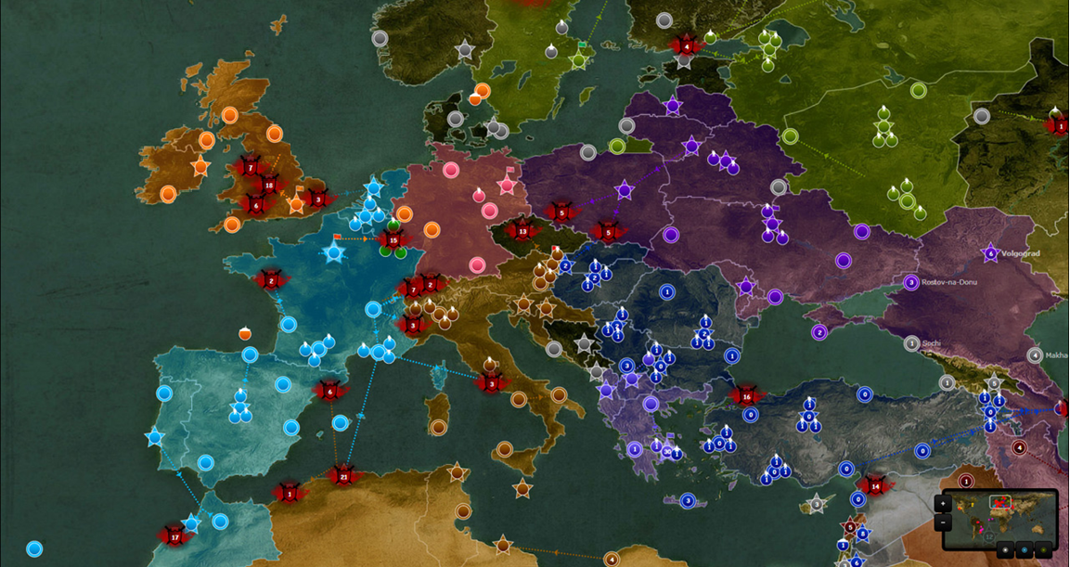
Notes:
Role of BI/Research to the org and my position

Slide 6
Notes:
Role of BI/Research to the org and my position

Slide 7
BRAND INNOVATION
Data Analytics
Market Intelligence
Audience Insights
Strategy
Notes:
As a brand with so much history, how do we remain competitive aside from keeping up with the digital age?
Not only how we innovate ourselves to keep up with technology, but also understanding our audience to help us maintain our competitive edge by looking into who they are and what they do.
Which brings me here today to talk to you about what we’ve learned about gamers that’s surprising to most and to dispel the notion of how people typically perceive gamers to be

Slide 8
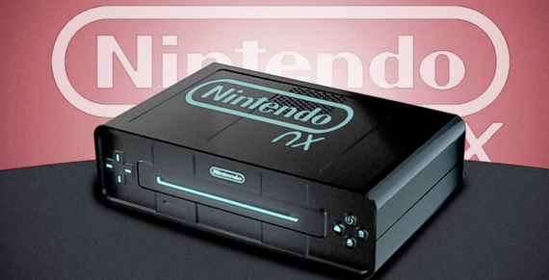
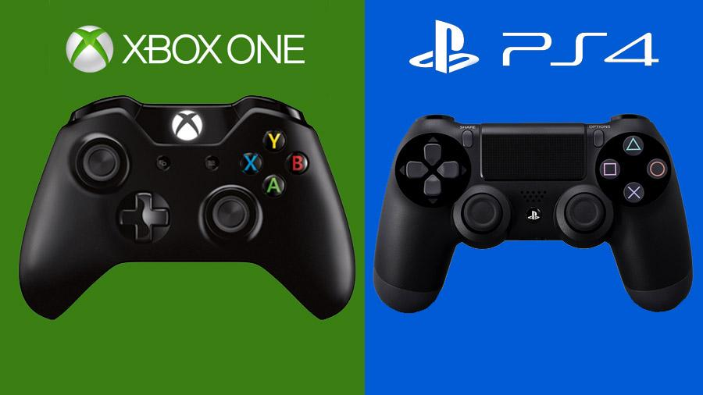
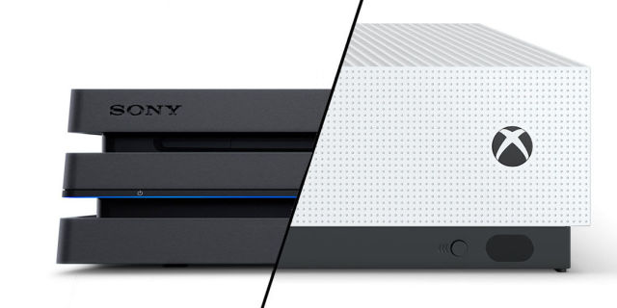
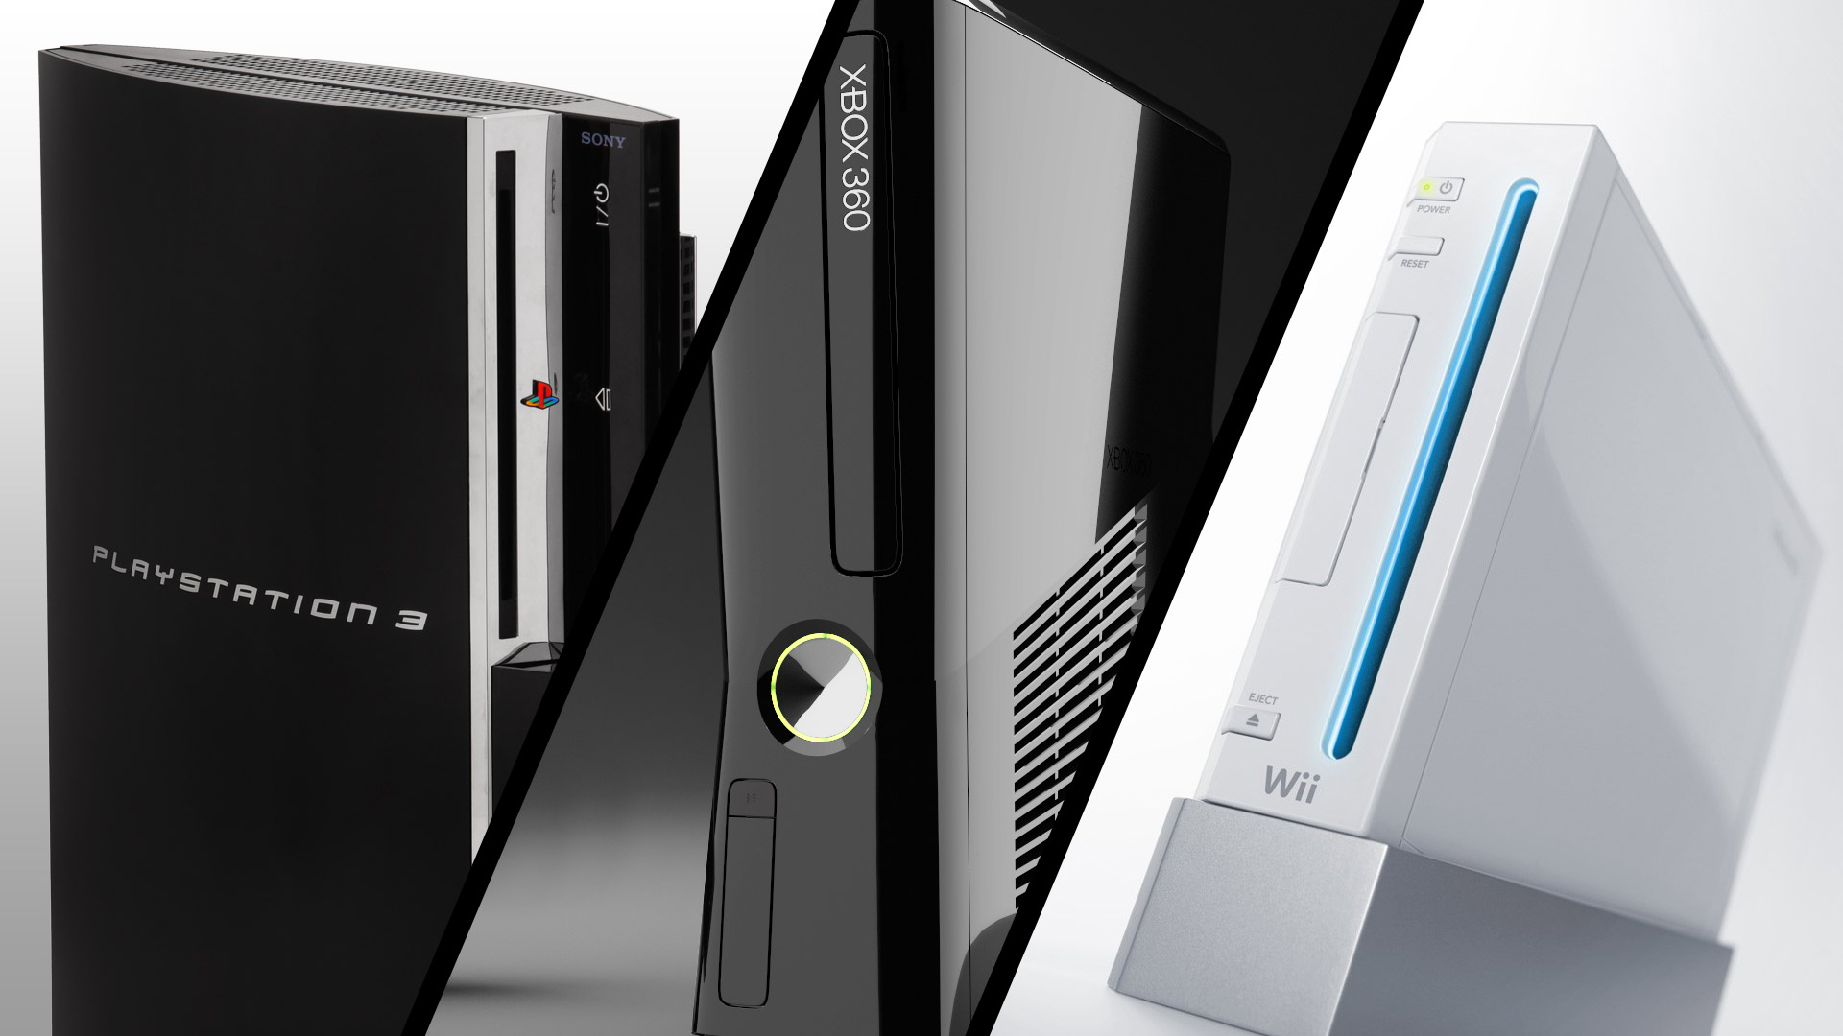
GAMING IS MORE EXPANSIVE THAN EVER BEFORE
2006
2007
2008
2009
2010
2011
2012
2013
2014
2015
2016
Notes:
Timeline of gaming – history, how it began, progressed and where we are now (add in social network and mobile)

Slide 9
DRIVING GROWTH IN INDUSTRY SPEND
Source: NPD

Slide 10
INDUSTRY CATEGORY SPEND
MOVIES
MUSIC
Notes:
Sources:
IFPI Digital Music Report, Apr’15
emarketer, US Movie Theater Box Office Revenues & Attendance, Feb'16
PwC, At the Gate and Beyond report, Oct’15
NPD 2015

Slide 11
GAMERS SPEND ON THE RISE
Gamer industry spend was $23.5B in 2015,
up 5% YoY & continuing to grow
GAMES
MOVIES
MUSIC
Notes:
Sources:
IFPI Digital Music Report, Apr’15
emarketer, US Movie Theater Box Office Revenues & Attendance, Feb'16
PwC, At the Gate and Beyond report, Oct’15
NPD 2015

Slide 12
Notes:
And who are gamers, how have they evolved? Then to now.

Slide 13
THE AVERAGE GAMER?
Notes:
What most people think of gamers...

Slide 14
THE AVERAGE GAMER?
Notes:
What most people think of gamers...

Slide 15
THE AVERAGE GAMER IS...
Highly social
Notes:
What most people think of gamers...

Slide 16
THE AVERAGE GAMER IS...
Highly social
Young skewing
Notes:
What most people think of gamers...

Slide 17
THE AVERAGE GAMER IS...
Highly social
Young skewing
Diverse
Notes:
What most people think of gamers...

Slide 18
THE AVERAGE GAMER IS...
Highly social
Young skewing
Diverse
Tech-driven
Notes:
What most people think of gamers...

Slide 19
GAMING IS UBIQUITOUS
From home setups (console & PC)
to on-the-go devices (portables & mobile)
59% of Americans play video games (150M)
80% of all households own a device for gaming
Source: ESA
Notes:
More prevalent than you would think!

Slide 20
GAMER INCIDENCE
Gaming continues to penetrate the U.S. market
Source: NPD
Notes:
Definition: A consumer that stated they have played video games on any device, own a gaming device AND have personally played a game on a game device in the past month

Slide 21
PC/CONSOLE
PORTABLES
MOBILE
SOCIAL NETWORK
Notes:
Today’s gamer – the gamer in all of us!

Slide 22
GAMER SEGMENTATION
PC/CONSOLE
38%
62%
AVG age: 27
Source: NPD, ESA, Newzoo
Notes:
Gamer segmentation

Slide 23
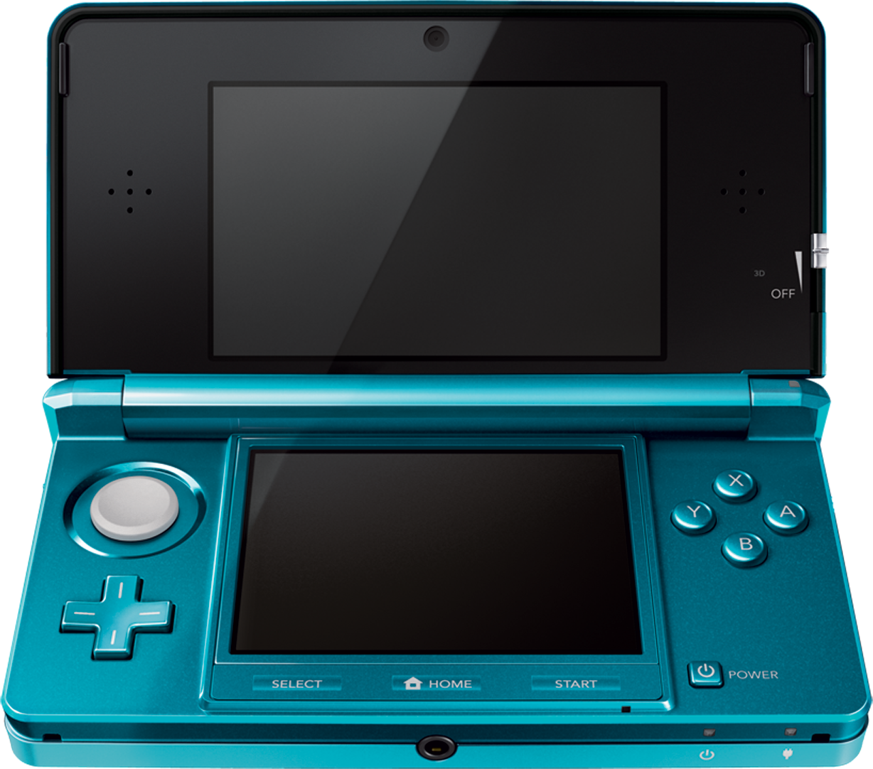
GAMER SEGMENTATION
PC/CONSOLE
PORTABLES
38%
45%
62%
55%
AVG age: 27
AVG age: 22
Source: NPD, ESA, Newzoo
Notes:
Gamer segmentation

Slide 24
GAMER SEGMENTATION
PC/CONSOLE
PORTABLES
38%
45%
62%
55%
AVG age: 27
AVG age: 22
SOCIAL NETWORK
31%
69%
AVG age: 43
Source: NPD, ESA, Newzoo
Notes:
Gamer segmentation

Slide 25
GAMER SEGMENTATION
PC/CONSOLE
PORTABLES
38%
45%
62%
55%
AVG age: 27
AVG age: 22
SOCIAL NETWORK
MOBILE
31%
69%
53%
47%
AVG age: 43
AVG age: 27
Source: NPD, ESA, Newzoo
Notes:
Gamer segmentation

Slide 26
MILLENNIAL REACH ONLINE
Top websites that Millennials tend to look up online
TV
SPORTS
LIFESTYLE
122 INDEX
34% Comp
120 INDEX
35 % Comp
115 INDEX
33 % Comp
Source: comScore
Notes:
Seeing how gamers are of the younger subset, certainly has a high % comp of millennials compared to other verticals.

Slide 27
HIGHER APPEAL FOR GAMING AMONG MILLENNIALS
Gaming info category: 98MM online reach
Millennials are more likely to search for gaming info online than other categories.
GAMES
TV
SPORTS
LIFESTYLE
167 INDEX
47% Comp
122 INDEX
34% Comp
120 INDEX
35 % Comp
115 INDEX
33 % Comp
Source: comScore
Notes:
Seeing how gamers are of the younger subset, certainly has a high % comp of millennials compared to other verticals.

Slide 28
DESIRABLE AUDIENCE
Gamers (especially the GameSpot audience) are tech savvy, have high purchasing power & are quick to adopt new trends and technologies.
They’re key influencers, providing advice on games (85%), tech (75%) and entertainment (89%).
GAMES
85%
TECH
75%
ENTERTAINMENT
89%
TOPICS THAT GAMERS ADVISE ON
Source: CBSi Internal
Notes:
Source: 2015 CBSi Games Audience Profile Study - add tidbit about topics they’ve given advice on

Slide 29
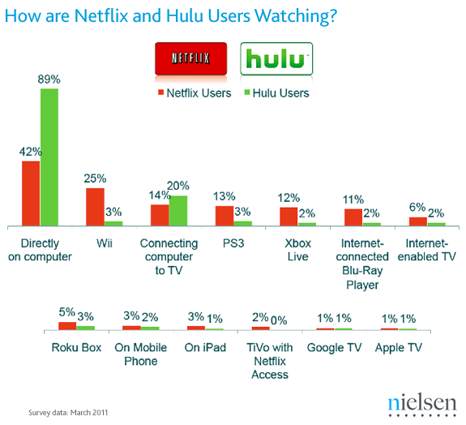
EARLY CORD CUTTERS EVEN BEFORE ONSET OF STREAMING MEDIA DEVICES & MOBILE
Combined, Consoles were the #1 device used for Netflix users at the time
Notes:
How do entertainment and tech relate? This new era of gamers are certainly driving new tech and hobbies.
For
Where is it going? More than just gaming – they’re an extremely desirable audience with more hobbies/interests beyond than just gaming.

Slide 30
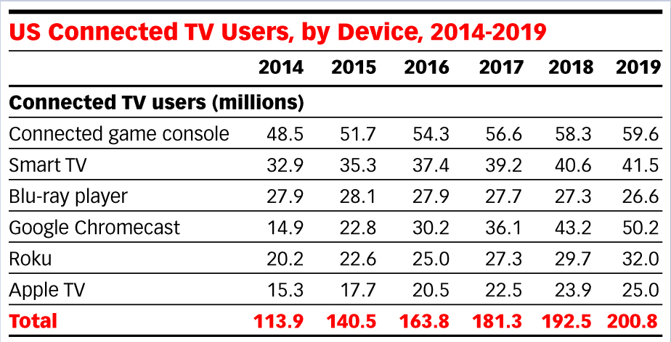
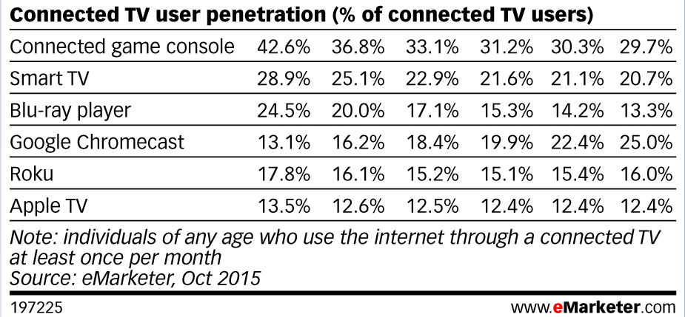
BINGEWATCHING PERSISTS GAMERS CONTINUE TO DRIVE LARGE MARKET SHARE
ASTOUNDING REACH
52MM OTT users used a gaming device to bingewatch in 2015
DRIVING LARGE MARKET SHARE
Gamers take up majority of OTT user penetration
Notes:
How do entertainment and tech relate? This new era of gamers are certainly driving new tech and hobbies.
For
Where is it going? More than just gaming – they’re an extremely desirable audience with more hobbies/interests beyond than just gaming.

Slide 31
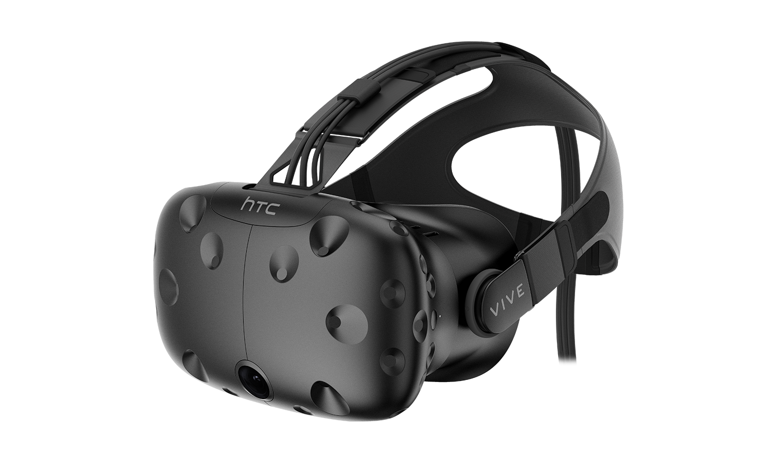
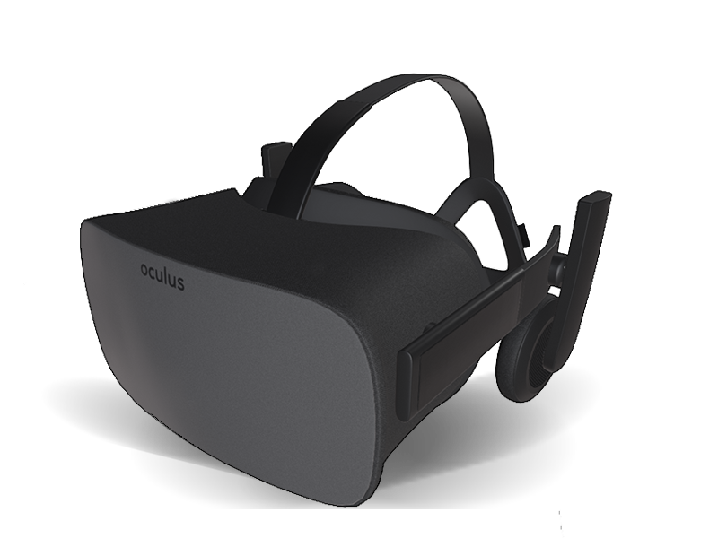
NEW TECH DRIVERS OF VR
...VR & AR market is expected to reach $80B by 2025 (roughly the size of the current desktop PC market)... –Goldman Sachs
Notes:
VR DRIVING TECH

Slide 32
EARLY ADOPTERS OF VR
 | Oculus Rift | PlayStation VR | HTC Vive
Price | $599 | $399 | $799
Release Date | March 2016 | Oct 2016 | April 2016
Requirements | Gaming PC ($950+) | PS4 ($350) | Gaming PC ($950+)
Total package (w/ everything) | $1,499 | $849 | $1,699

Slide 33
NEW TECH DRIVERS OF VR
...and inspiring new tech adoptions for other verticals,
the possibilities are endless!
Notes:
VR DRIVING TECH

Slide 34
GAMER PROFILE SUMMARY
“SELFIE GENERATION”
Extremely social with a high millennial skew
HIGH SPENDING POWER
Games industry continues to grow at a fast rate, higher than movie/music industries
ENTERTAINMENT
Various hobbies aside from just gaming alone, e.g. cord-cutters
EARLY TECH ADOPTERS
Open to new tech and act as drivers for innovation (VR)
Notes:
Gamer wrap up – more varied than one would think

Slide 35
Notes:
What does it mean for a media co? It’s about how we innovate ourselves aside from keeping up with technology (device platform) and extending our reach to reach the ‘selfie generation’.
Orbiting it are our different distribution platforms (or planets)… which rely on GS (or the sun) for content (life).
This includes our Facebook and Twitter feeds, YouTube channel and the use of GS content within the CNET gaming tab
We’re also in the (very) early days of creating/publishing content to Snapchat (Username: GameSpot.com)
For your reference:
Facebook (Jan 16) WW
Follower Reach UV: 101,021
Non Follower Reach UV: 117,118,261
Total Reach UV: 218,140,126

Slide 36
Notes:
What does it mean for a media co? It’s about how we innovate ourselves aside from keeping up with technology (device platform) and extending our reach to reach the ‘selfie generation’.
Orbiting it are our different distribution platforms (or planets)… which rely on GS (or the sun) for content (life).
This includes our Facebook and Twitter feeds, YouTube channel and the use of GS content within the CNET gaming tab
We’re also in the (very) early days of creating/publishing content to Snapchat (Username: GameSpot.com)
For your reference:
Facebook (Jan 16) WW
Follower Reach UV: 101,021
Non Follower Reach UV: 117,118,261
Total Reach UV: 218,140,126

Slide 37
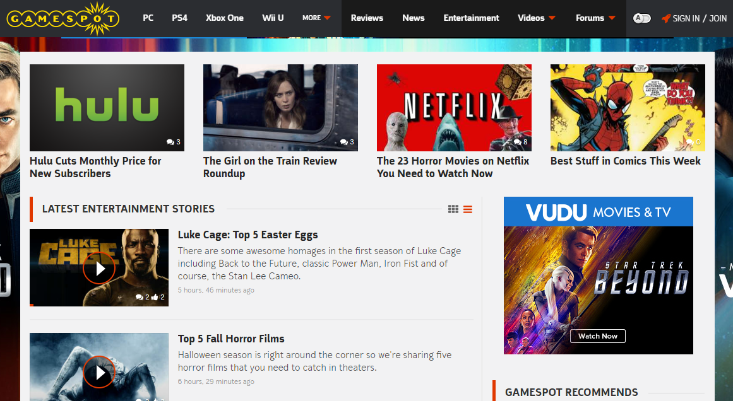
ENTERTAINMENT CONTENT
Notes:
Not only did we sought out more gamers on other channels, but powered with these insights, we re-invented ourselves to think about our audience differently by understanding what they do.

Slide 38
SMART INSIGHTS
INDUSTRY INTEL
MEDIA
PRODUCT ENGAGEMENT & INTERACTIONS
AUDIENCE
Notes:
The end. Leveraging data to learn about our audience and distill insights to re-invent ourselves not only for our product but also as a marketable brand for advertisers

Slide 39
SMART INSIGHTS
MARKETING
INDUSTRY INTEL
MEDIA
PRODUCT ENGAGEMENT & INTERACTIONS
AUDIENCE
PRODUCT STRATEGY
Notes:
The end. Leveraging data to learn about our audience and distill insights to re-invent ourselves not only for our product but also as a marketable brand for advertisers

Slide 40
QUESTIONS?
Tiffany.Sanders@cbsi.com
Notes:
The end. Leveraging data to learn about our audience and distill insights to re-invent ourselves not only for our product but also as a marketable brand for advertisers

